Slide 1

Introduction to Python, Syntax & Nomenclature
Let's grab the basics!
Prathmesh Palande
Pratik Loya
TOC EUS Automation
May 14, 2019

Slide 2
Section 1
Introduction To Python

Slide 3
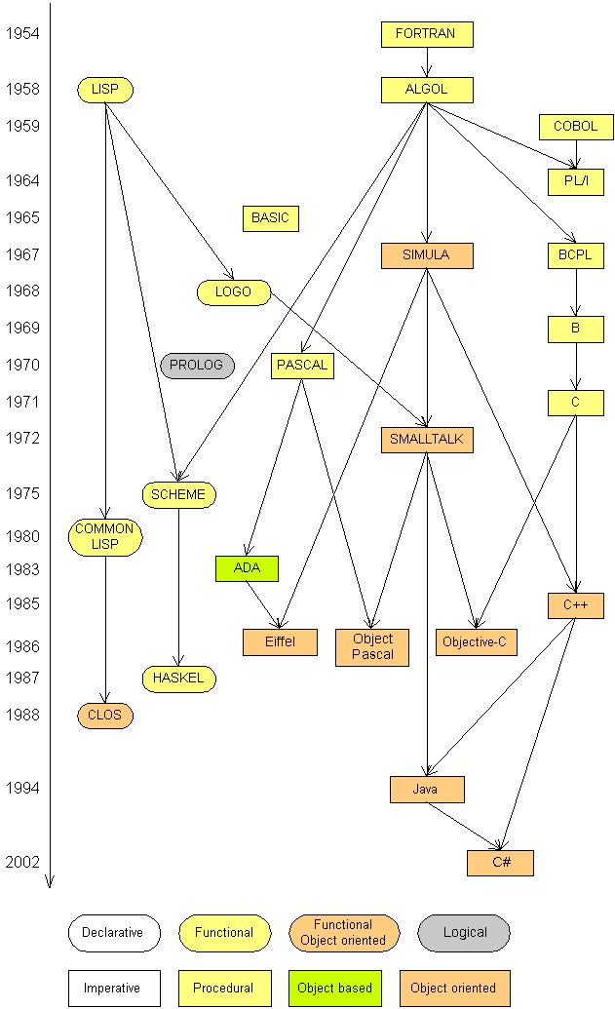

Into the History
Python was originally conceptualized by Guido van Rossum in the late 1980s as a member of the National Research Institute of Mathematics and Computer Science
Python 0.9.0 was first released in 1991
Guido Van Rossum – retired Benevolent dictator for life (BDFL)
Fun fact. Python is not named after the snake. It’s named after the British TV show Monty Python

Slide 4
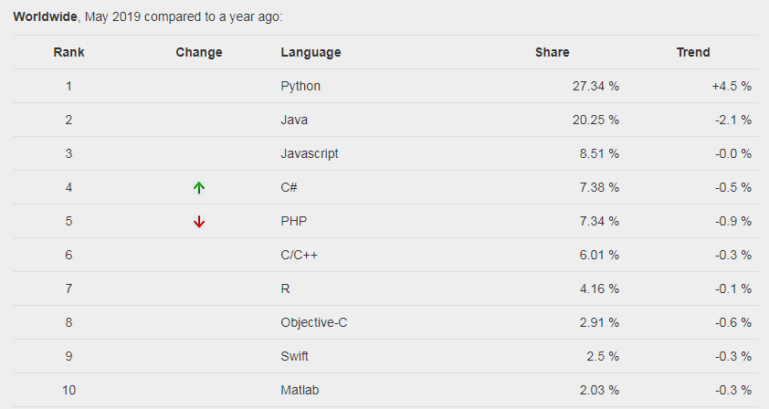
Python Statistics

Slide 5
Introduction
Python is a high-level programming language
Open source and community driven
Source can be compiled or run just-in-time
“Tried and true” language that has been in development since 1991
It is used for:
web development (server-side),
software development,
mathematics,
system scripting.

Slide 6
Why Python?
Python works on different platforms (Windows, Mac, Linux, Raspberry Pi, etc).
Python has a simple syntax similar to the English language.
Python has syntax that allows developers to write programs with fewer lines than some other programming languages.
Python runs on an interpreter system, meaning that code can be executed as soon as it is written. This means that prototyping can be very quick.
Python can be treated in a procedural way, an object-orientated way or a functional way.

Slide 7
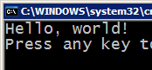



Compilation Vs Interpretation
Many languages require you to compile (translate) your program into a form that the machine understands.
Python is a hybrid of byte-code interpreted and/or compiled language.
compile
execute
source code
Hello.java
byte code
Hello.class
output
Hybrid
interpret
source code
Hello.py
output

Slide 8
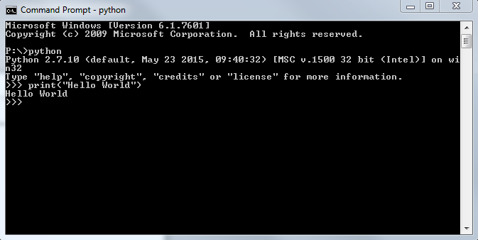
Programming Basics
code or source code: The sequence of instructions in a program.
syntax: The set of legal structures and commands that can be used in a particular programming language.
output: The messages printed to the user by a program.
console: The text box onto which output is printed.
Some source code editors pop up the console as an external window, and others contain their own console window.
Syntax
Output
Code
Console

Slide 9
Let's begin with print()
Bult-in function
Prints the values to standard output (console)
Values are seperated by space by default (sep)
After the last value newline symbol \n is appended by default (end)
print('Hello', 'world') Hello world
print('Hello', 'world', sep='_') Hello_world
print('Hello', end=' ') print('world') Hello world
My name is \r
"Pratik"

Slide 10

Seeing the code in action
Open Command Prompt (Windows) or Terminal (OS/Unix)
Change directory by running: cd {path_to_your_code}
Run program: python hello.py

Slide 11
Indentation and Blocks
Python uses whitespace and indents to denote blocks of code
Lines of code that begin a block end in a colon:
Lines within the code block are indented at the same level
To end a code block, remove the indentation
You'll want blocks of code that run only when certain conditions are met
Example: (Python Devs be like, "Semi colons and curly braces are NOT needed!")
In Java:
for(int i = 0; i < 10; i++) {
System.out.println("Hello World 10 times");
}
In Python:
for i in range(10):
print("Hello World 10 times")
print("Hello")
print("world")

